Slide 1

The NBA MVP
UC Berkeley Data Analytic Bootcamp
By Billy Huang
https://github.com/QQrex/Predicting_NBA_MVP_by_the_Stats

Slide 2
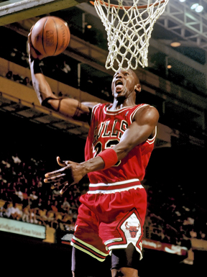
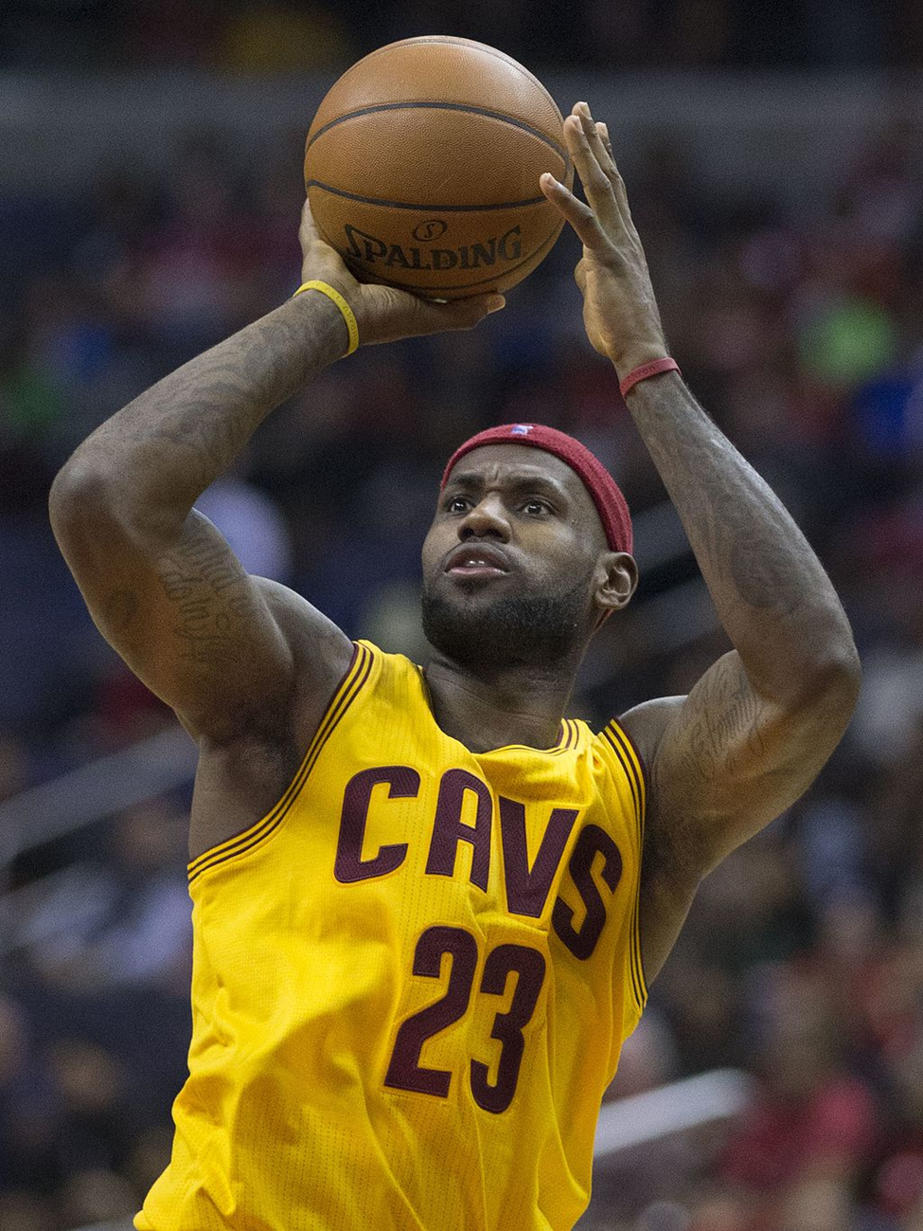
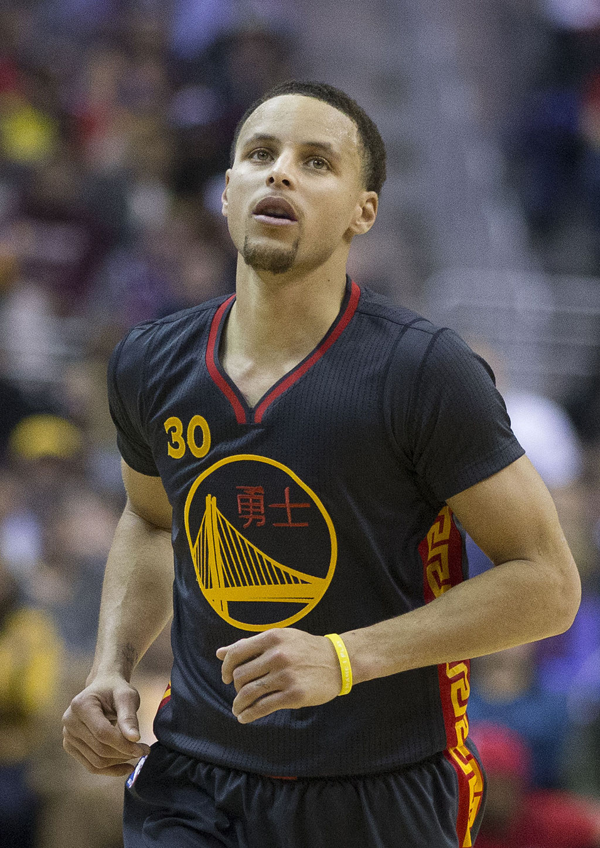
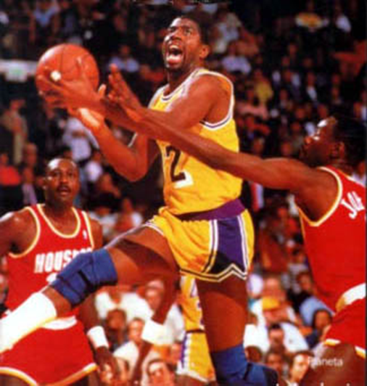

Who are these people?

Slide 3
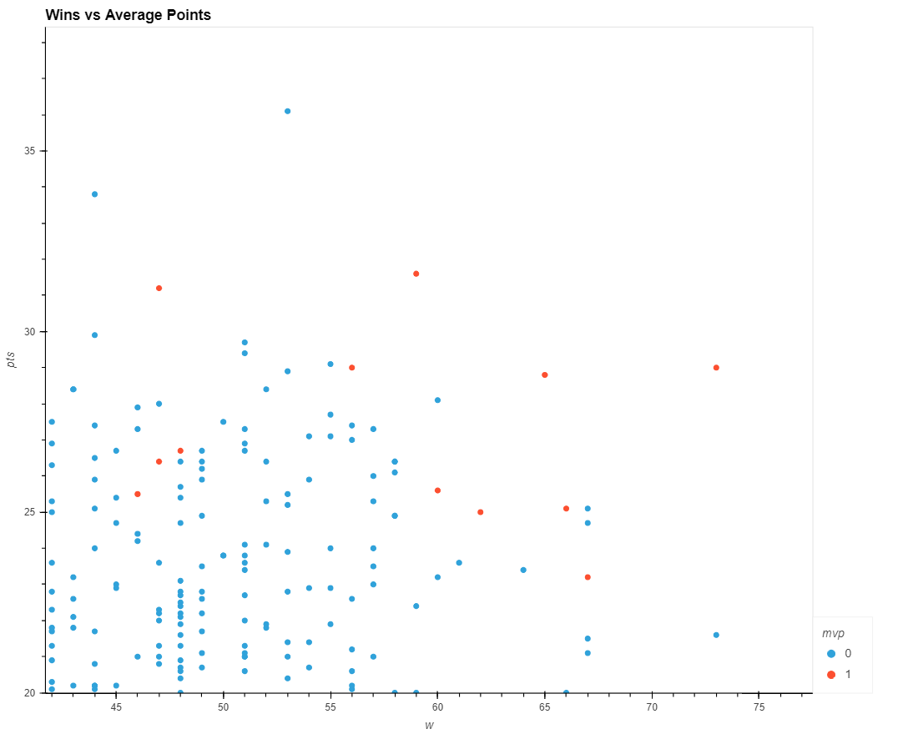

Who wins and scores the most?
Data from season 2010-present

Slide 4
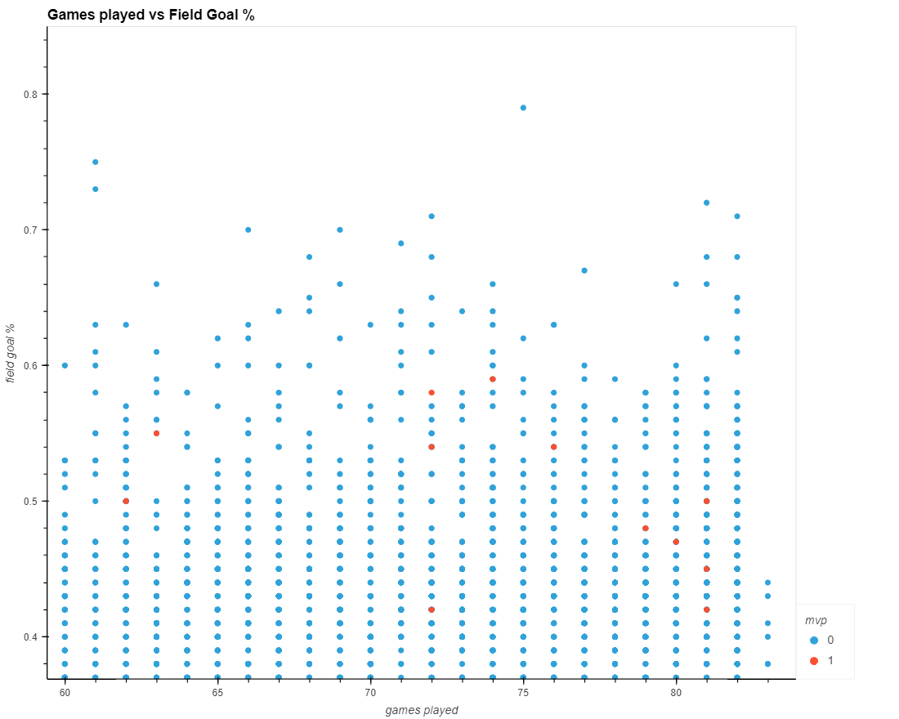

Efficiency?
Data from season 2010-present

Slide 5
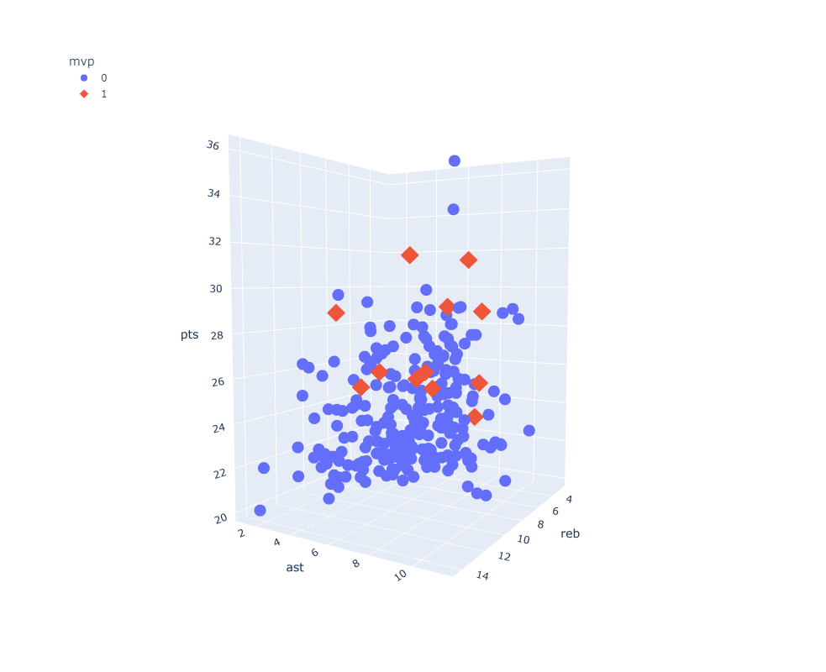

The Trinity
Points
Assists
Rebounds
Here you give a brief intro of the topic you want to talk about. For example, you can talk about Mercury
Data from season 2010-present

Slide 6

Machine Learning for the Assist
Notes:
So let us see if we can use our knowledge of supervised machine learning to give us the assist in predicting the MVP for this season. But, before we get to ahead of ourselves, we need to think about where and how to get our data for our analysis.

Slide 7

Our Data Timeline
1955
2022
2010
Notes:
The NBA has been handing out the MVP award since 1955, however, we will not be extracting data that far back due to amount of time it would take to extract. Our focus will be from 2010 to the present to train and test our machine learning models.

Slide 8
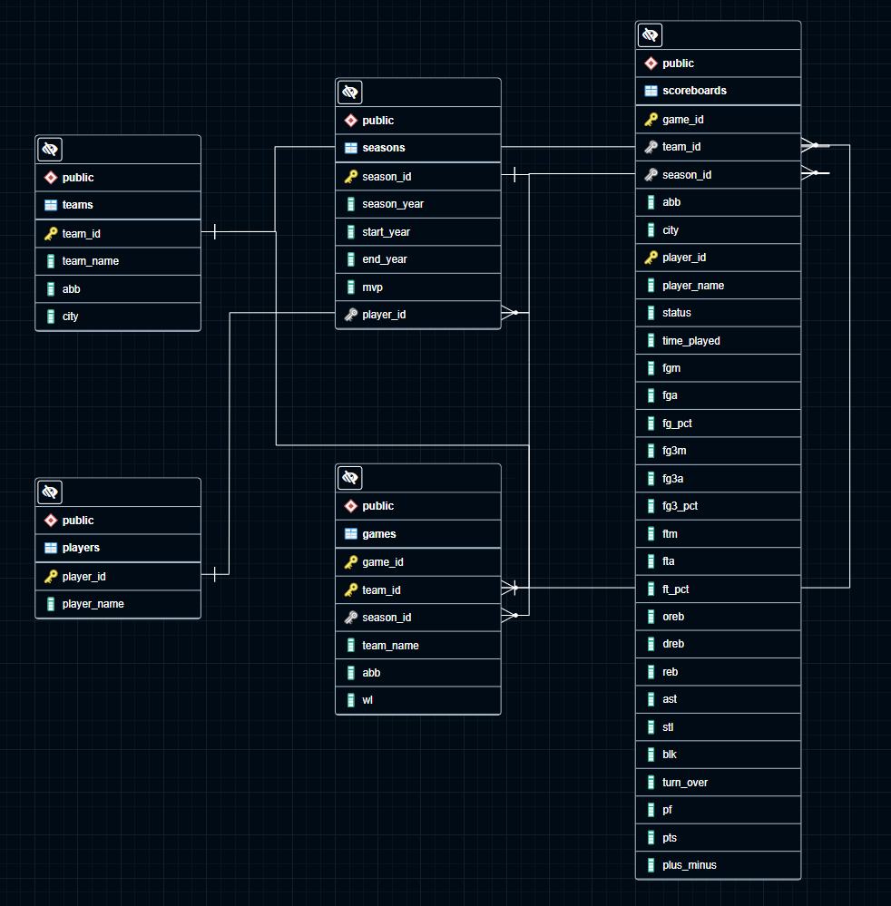

ERD
Notes:
I extracted my data from NBA.com with the help from a client package developed by the contributors at Github repo nba_api. They provided extensive documentation and example on to use their client package to extract from the various endpoints at NBA.com. Once the data was successfully extracted, I proceeded to load the data into Postgres SQL Database to store. As you can see from my ERD we have 5 tables, teams, players, seasons, games, and scoreboards table. With the scoreboards table holding box score data for most of our features for our machine learning model.

Slide 9
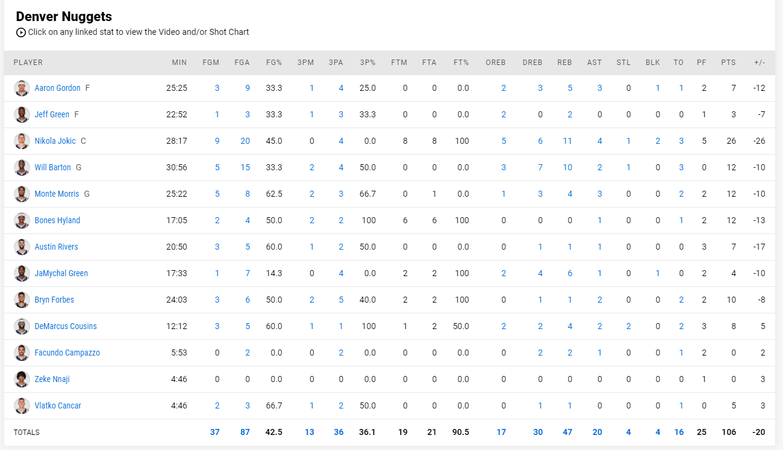

Box Score example
Notes:
For those of you who aren’t familiar with an NBA box scores, at the end of a game, all of a players stats from each team is tallied up from their points scored to turn overs.

Slide 10
Workflow
Preprocessing
Juypter notebook
Database
Machine Learning
Postgres SQL database
SKlearn library
Notes:
So far in our workflow we have created database to house our data. Our next step will be to connect our DB to Jupyter notebook to begin preprocessing for our machine learning models

Slide 11
Preprocessing
01
03
02
04
Stats
Train, test, split
Average box score stats, games played, win, mvp label
Split our data into training, testing data.
Separate
Scale
Separate our features and target label
Scale data with sklearn.
Notes:
For preprocessing, we created a dataframe with each player in a season with their average box score stats, how many games they played, how many games they won, and which player was labelled as an MVP that season. Next, we separated our features and targets, split our data into training and test data and finally scaled our data with sklearn’s StandardScaler

Slide 12

Room
Hi, my name is Class Imbalance
Notes:
Before moving onto our machine learning models, we need to address the large elephant in the room for our data, class imbalance. Seeing how there is 30 teams with 15 players on each team and we have 11 seasons worth of data. We have a total 11 MVPs out of 4950 players. That is very imbalance dataset.

Slide 13
Addressing Class Imbalance
Random Oversample
SMOTE
SMOTEEN
Notes:
To address our class imbalance, we will try random oversampling, SMOTE and SMOTEEN to see which technique has the most success in combating our class imbalance.

Slide 14
Machine Learning Models
Abbreviation | Models
LR | Logistic Regression
SVM | Support vector machine
DT | Decision Tree
RT | Random Forest
B | Gradient Boosting
Notes:
And for our Machine Learning models we will train and test logistic regression, support vector machine, decision tree, random forest and gradient boosted.

Slide 15
RESULTS
ACCURACY SCORE : 0.99
Notes:
After training and testing, we had high accuracy scores for all models! However, accuracy score is not a good metric to measure the success of our model in this case. in order to determine how well our models really performed, what we are more interested in is seeing is our precision, recall and f1 scores.

Slide 16
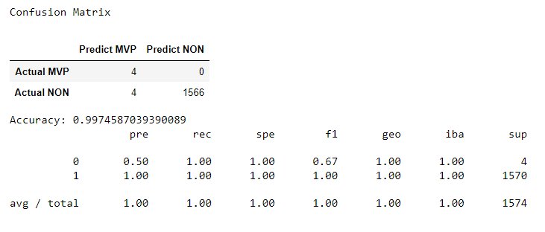
Logistic Regression
SMOTE
Precision: 0.50
Recall: 1.00
F1: 0.67
Notes:
For our logistic regression models, our best performer utilizes SMOTE and had a precision score of 0.50, recall of 1.0 and F1 of 0.67.

Slide 17
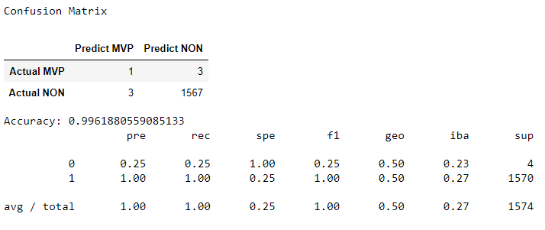
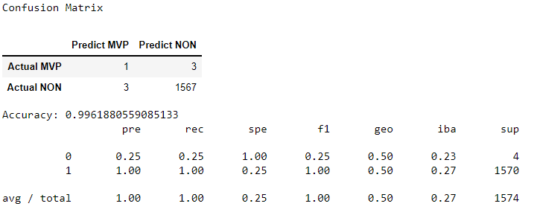
Support Vector Machine
Random Oversampling
Precision: 0.25
Recall: 0.25
F1: 0.25
SMOTE
Precision: 0.25
Recall: 0.25
F1: 0.25
Notes:
There was a tie for our support vector machines models in performance. Both models utilizing Random Oversampling and SMOTE had the same precision score of 0.25, recall of 0.25 and F1 of 0.25.

Slide 18
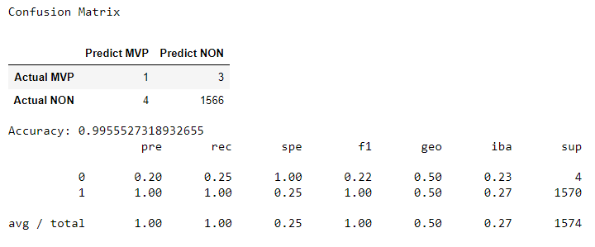
Decision Tree
Random Oversampling
Precision: 0.2
Recall: 0.25
F1: 0.22
Notes:
Our best decision tree model utilizing Random Oversampling had a precision score of 0.2, recall of 0.25 and F1 score of 0.25.

Slide 19
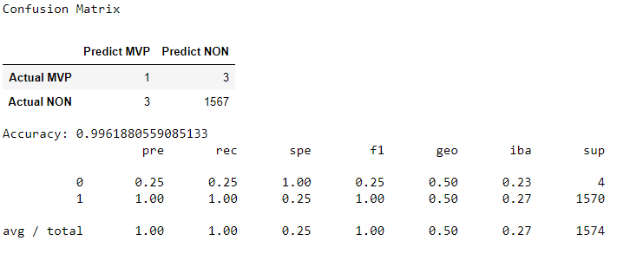
Random Forest
SMOTEEN
Precision: 0.25
Recall: 0.25
F1: 0.25
Notes:
Random forest performed the best utilizing SMOTEEN with precision score of 0.25, recall of 0.25 and F1 of 0.25 performed the best.

Slide 20

Gradient Boosted
SMOTEEN
Precision: 0.25
Recall: 0.25
F1: 0.25
Notes:
And finally, our Gradient Boosted model utilizing SMOTEEN with precision score of 0.25, recall of 0.25 and F1 of 0.25 performed the best. In summary, our best model did not even crack a F1 score of 0.7. However, what would be the resulting predictions if we plugged in this season’s data?

Slide 21
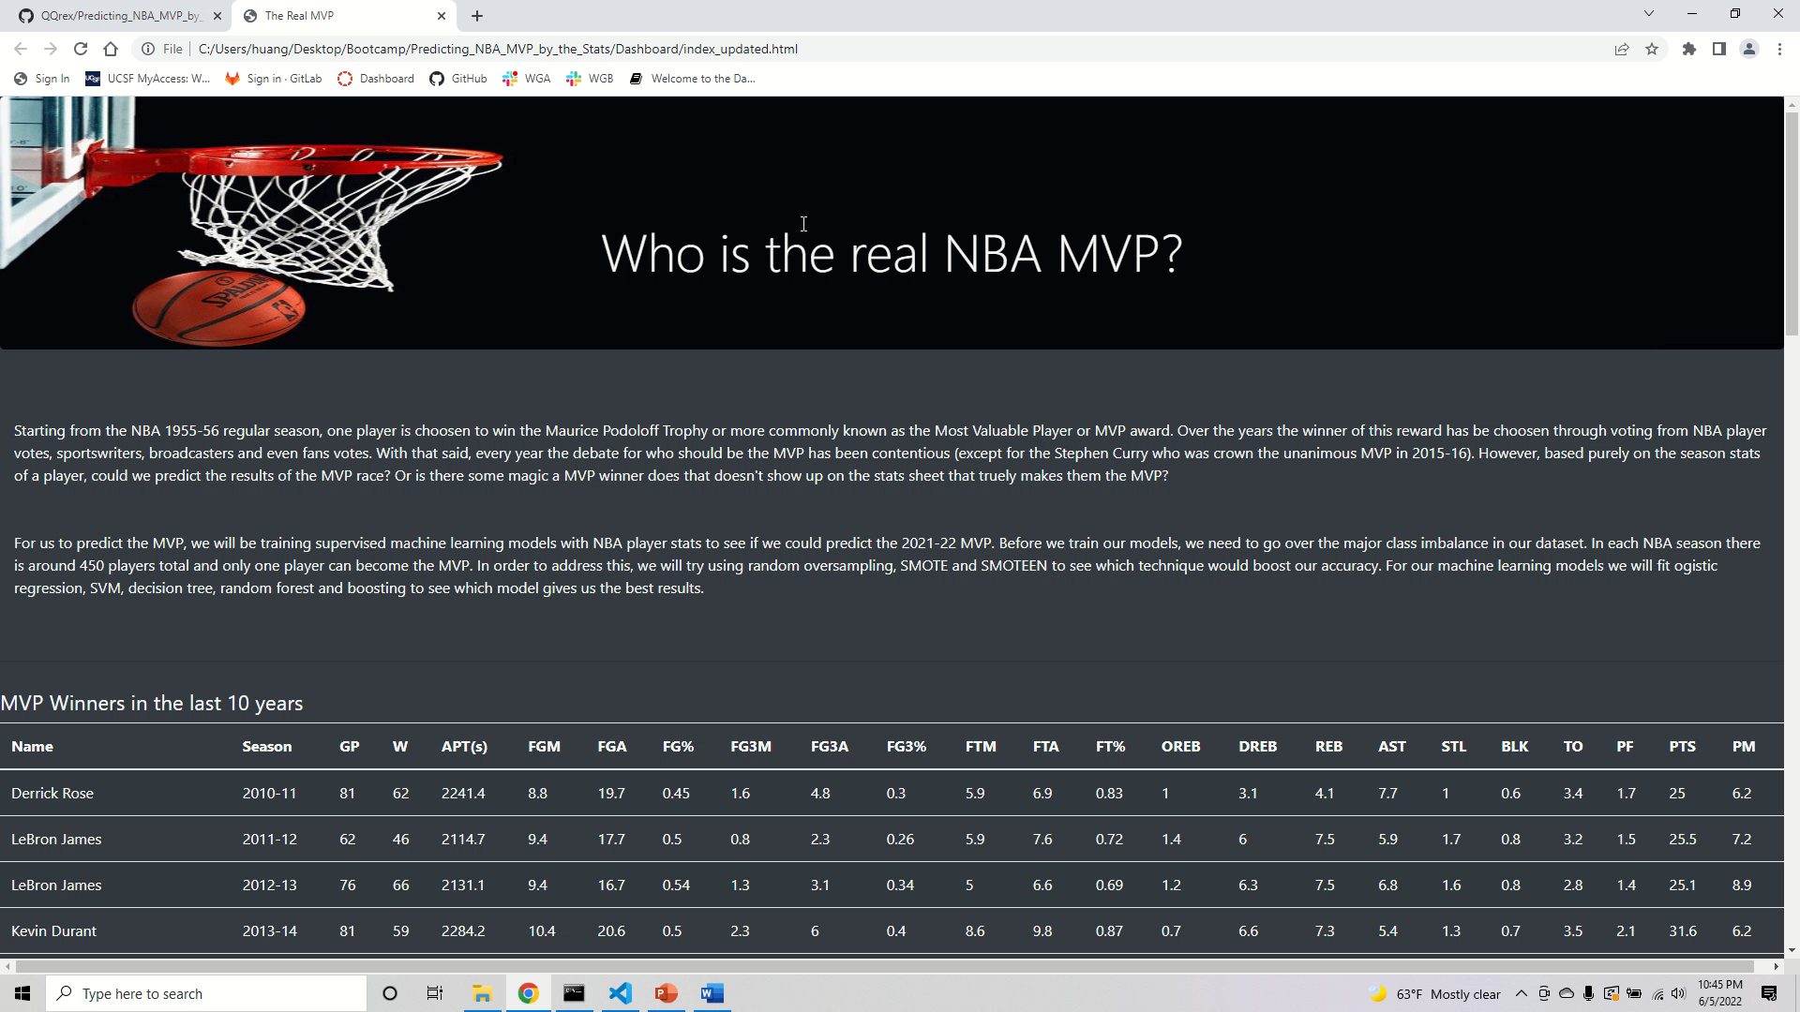
Dashboard
Notes:
Well, I created a dashboard that displays my results. The dashboard holds two tables. One is a table of all the MVPs since 2010. The other table is an interactive table with a filter search query of Class imbalance technique and machine learning model used.

Slide 22
Recommendations
More Data
New Features
Try different models
More data to train and test our models
Find new metrics to train our model
Deep learning
Notes:
Finally, we will conclude our presentation with recommendations for future analysis. The first recommendation is more data. More data may be needed to train and test our model to achieve higher precision, recall and F1 scores. New features may bring insight and better predictions to our models, for example, how many winning games a player score over 40 points in a season or how many games a player closed out and won. Lastly, picking a different model altogether like a deep learning model, however this may take considerably more time to train and optimize.

Slide 23
Fin

Slide 24
Resources and Tools
Resources
Tools
NBA.com
https://github.com/swar/nba_api
https://en.wikipedia.org/wiki/NBA_Most_Valuable_Player_Award
Postgres
Jupyter Notebook
Pandas Library
Sklearn Library
Matplotlib Library
Hvplot Library
Visual Studio Code

